Slide 1
Statistical source expansion for question answering
CIKM’11
Advisor：Jia Ling, Koh
Speaker：SHENG HONG, CHUNG

Slide 2
Outline
Introduction
Approach
Retrieval
Extraction
Scoring
Merging
Experiment
Intrinsic evaluation
Application to QA
Conclusion

Slide 3
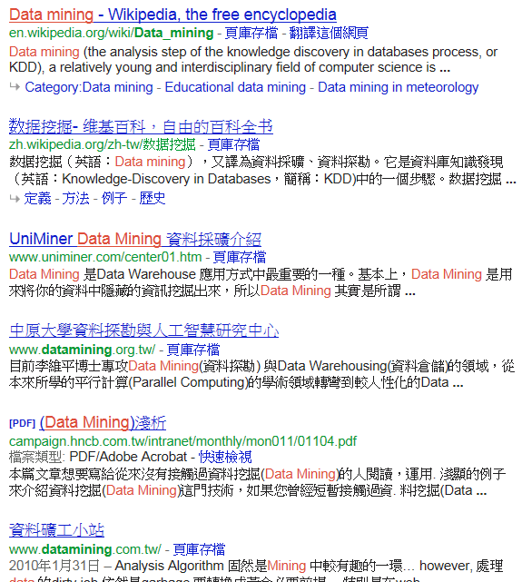
Search engine V.S QA system
Query: Data mining

Slide 4
Search engine V.S QA system
Who is Jeremy lin?
Source
QA system
Jeremy Shu-How Lin (born August 23, 1988) is an American professional basketball player with the New York Knicks of the National Basketball Association (NBA). After receiving no athletic scholarship offers out of high school and being undrafted out of college, the 2010 Harvard University graduate reached a partially guaranteed contract deal later that year with his hometown Golden State Warriors.

Slide 5
Search engine V.S QA system
What is Melancholia?
Source
QA system
No information or
lack of information
Source
Expansion
Bad Result

Slide 6
Introduction
Question Answering(QA)
Good coverage for a given question domain
May not contain the answers to all question
Source expansion
Improve coverage
Facilitate extraction and validation of answers
Statistical model

Slide 7
Source(Wikipedia, Wiktionary)
Pseudo-document
Seed
document
approach
Seed
document
QA system
approach
.
.
.
.
.
.
Seed
document
approach

Slide 8
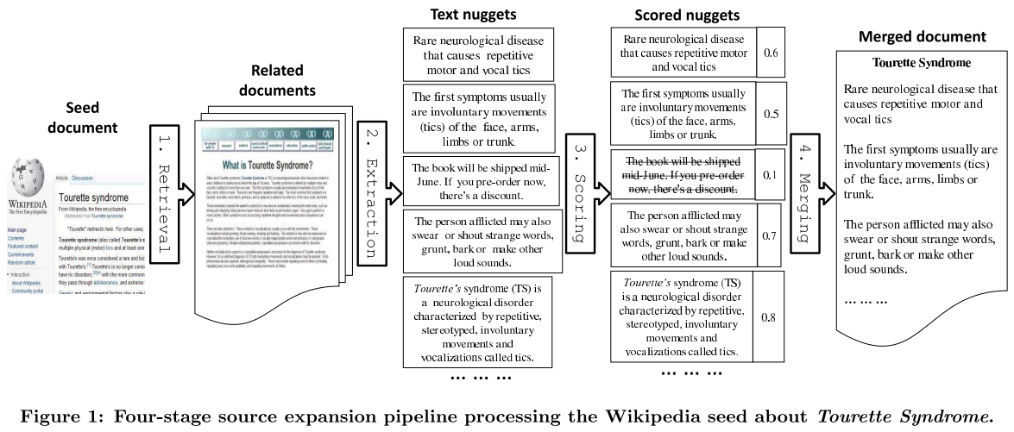
Approach

Slide 9
Retrieval && Extraction
Perform Yahoo! Search
Fetch up to 100 web pages links
Extraction
Nugget
Html paragraphs: <p>…</p>
List items: <li>…</li>
Table cells: <table>…</table>
Markup-based nugget v.s sentence-based nugget

Slide 10
Retrieval && Extraction
Extraction
Markup-based nugget v.s sentence-based nugget
Markup-based
Sentence-based
Jeremy Shu-How Lin (born August 23, 1988) is an American professional basketball player with the New York Knicks of the National Basketball Association (NBA). After receiving no athletic scholarship offers out of high school and being undrafted out of college, the 2010 Harvard University graduate reached a partially guaranteed contract deal later that year with his hometown Golden State Warriors.
Jeremy Shu-How Lin (born August 23, 1988) is an American professional basketball player with the New York Knicks of the National Basketball Association (NBA).
After receiving no athletic scholarship offers out of high school and being undrafted out of college, the 2010 Harvard University graduate reached a partially guaranteed contract deal later that year with his hometown Golden State Warriors.

Slide 11
Approach

Slide 12
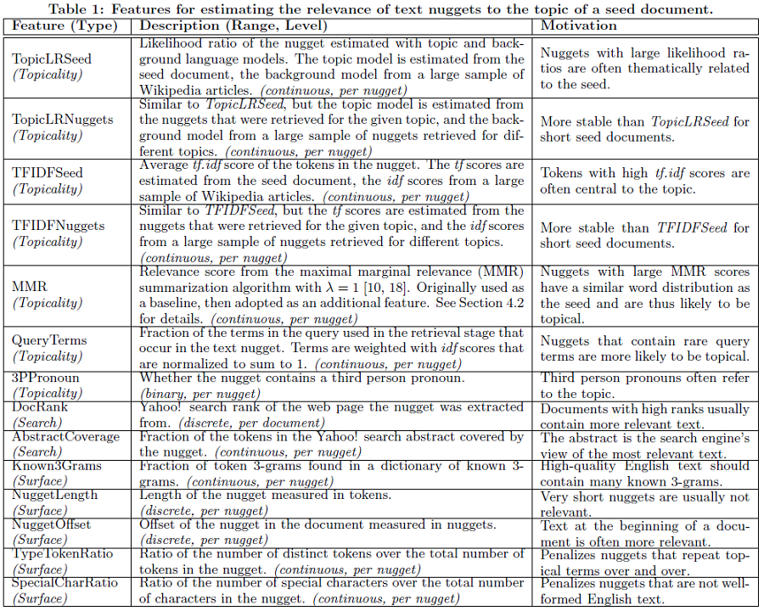

Slide 13
Expansion
Source
nugget₁
Web
documents
nugget₂
nugget₃
seedPer()
Web
documents
TopicLRSeed =
$$\frac{Percentage(nugget terms in seed doucument)}{Percentage(nugget terms in whole documents )}$$
.
.
corPer()
TopicLRNugget =
$\frac{Percentage(nugget terms in web document)}{Percentage(nugget terms in different web documents)}$
Web
documents
13

Slide 14
Expansion
Source
seedPer(w) = $\frac{w frequency in doc}{all words in doc}$
nugget₁
corPer(w) = $\frac{w frequency in corpus}{all words in corpus}$
Web
documents
nugget₂
nugget₁ : {w₁,w₂,w₃}
nugget₃
seedPer(w1) = 0.7
seedPer(w2) = 0.6
seedPer(w3) = 0.1
corPer(w1) = 0.1
corPer(w2) = 0.5
corPer(w3) = 0.6
.
.
Web
documents
TopicLRSeed = 0.7/0.1 * 0.6/0.5 * 0.1/0.6 = 1.4
Web
documents
TopicLRNugget =
$\frac{Percentage(nugget terms in web document)}{Percentage(nugget terms in different web documents)}$

Slide 15
Expansion
Source
nugget₁
Web
documents
nugget₂
nugget₃
TFIDFSeed =
tf(term frequency in seed doc) *
idf(inverse document frequency from source document)
.
.
Web
documents
TFIDFNugget =
tf(term frequency in web doc) *
idf(inverse document frequency from other web docs)
Web
documents

Slide 16
Expansion
Source
tf(w) : w frequency in doc
nugget₁
Web
documents
df(w) : doc contains w
nugget₂
idf(w) : inverse df(w)
nugget₃
nugget₁ : {w₁,w₂,w₃}
All doc:{d1~d10}
.
.
Web
documents
tf(w1) = 7
tf(w2) = 0
tf(w3) = 3
idf(w1) = log(9/1)
idf(w2)
idf(w3) = log(9/6)
TFIDFSeed = (7*log9 + 0 + 3*log1.5)/3 = 2.4
Web
documents
TFIDFNugget =
tf(term frequency in web doc) *
idf(inverse document frequency from other web docs)

Slide 17
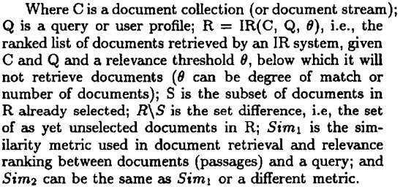
Maximal Marginal relevance
Solve redundant problem
Ex: query:”馬英九”
all documents are related to president
Combined two metrics
Relevant
Novelty

Slide 18
collection
IR system
D₁~D₁₀
query
λ = 1
MMR = Sim(D_{i},Q)
Give a threshold
Top 5
1-iter
S:{∅}
R/S:{D₁, D₂, D₄, D₆, D₈, D₉, D₃, D₅}
D₁
D₂
D₄
D₆
D₈
D₉
D₃
D₅
2-iter
S:{D₁}
R
R/S:{D₂, D₄, D₆, D₈, D₉, D₃, D₅}
λ sim(D2)- (1-λ)*sim(D1,D2)
λ sim(D4)- (1-λ)*sim(D1,D4)
λ sim(D6)- (1-λ)*sim(D1,D6)
λ sim(D8)- (1-λ)*sim(D1,D8)
.
.
.
3-iter
S:{D_{1,} D₆}
R/S:{D₂, D₄, D₈, D₉, D₃, D₅}
threshold
.
.
.
D₇
D₁₀

Slide 19
3PPronoun
Expansion
Lin
is a PG
Source
Lin
is a basketball player
He
Lin
Web
documents
He
studied in Harvard
DocRank && AbstractCoverage
Search absrtact coverd by nugget
.
.
Web
documents
Nuggetlength
Terms in Nugget
Web
documents
NuggetOffset
Text at the beginning of the doc is more relevant
19

Slide 21
Scoring
Linear regression
y = a₀ + a₁x₁
Logistic regression model
Non-linear
Logit function
p(t) = , [0,1]
p(y = a₀ + a₁x₁ +…+ a₁₄x₁₄), [0,1]

Slide 22
Approach

Slide 23
Merging
Drop the nuggets if their relevance scores are below an absolute threshold(0.1)
Stop merging if total character length of all nuggets exceeds a threshold(10 times)
The remaining nuggets are compiled into a pseudo-document

Slide 24
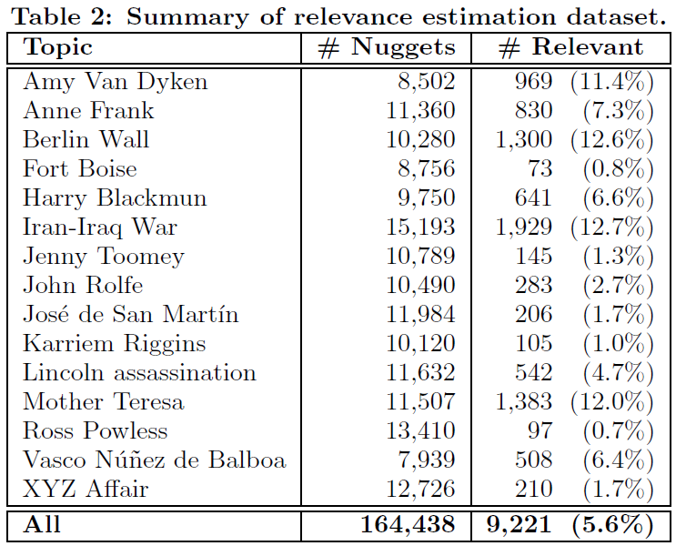
Experiment
Intrinsic evaluation
Application to QA

Slide 25
Intrinsic evaluation
15 Wikipedia articles
Human annotators select relevant substrings
A nugget was considered relevant if any of its tokens were selected by an annotator
Evaluate different relevance models
Sentence-level
Markup-level

Slide 26
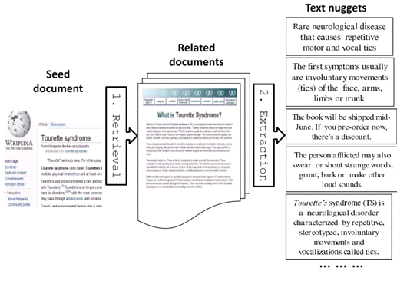
Intrinsic evaluation
Different relevance models
Random
Round Robin
Search Rank
MMR
LR independent
LR adjacent

Slide 27
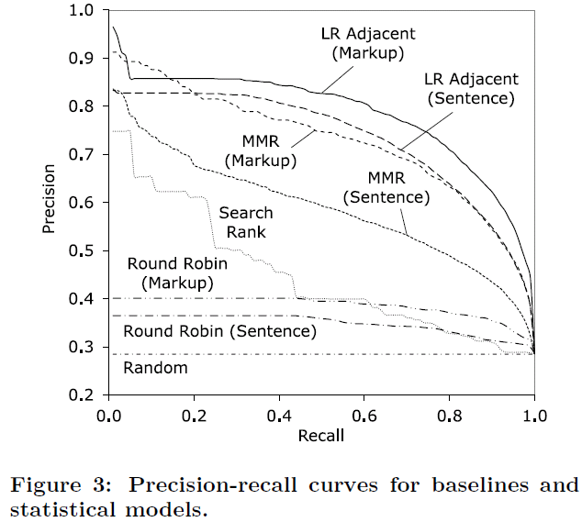
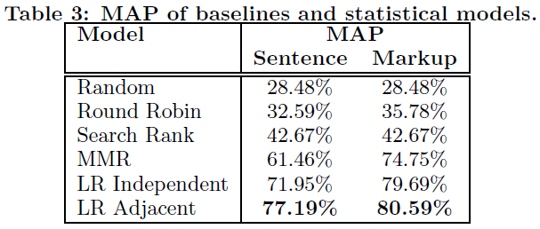
Intrinsic evaluation

Slide 28
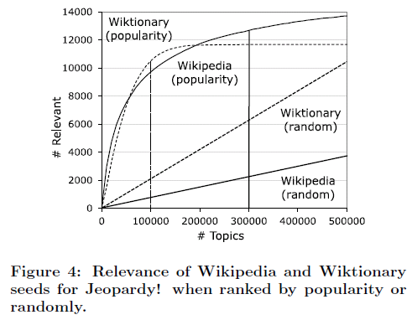
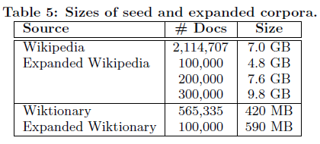
Application to QA
Dataset
Jeopardy!
TREC questions
Expanded sources
Wikipedia && Wiktionary(baseline)
All source
Encyclopedias(wikipedia, world book)
Dictionaries(wiktionary, thesauri)
Newswire(AQUAINT, New York Time archive)
Literature

Slide 29
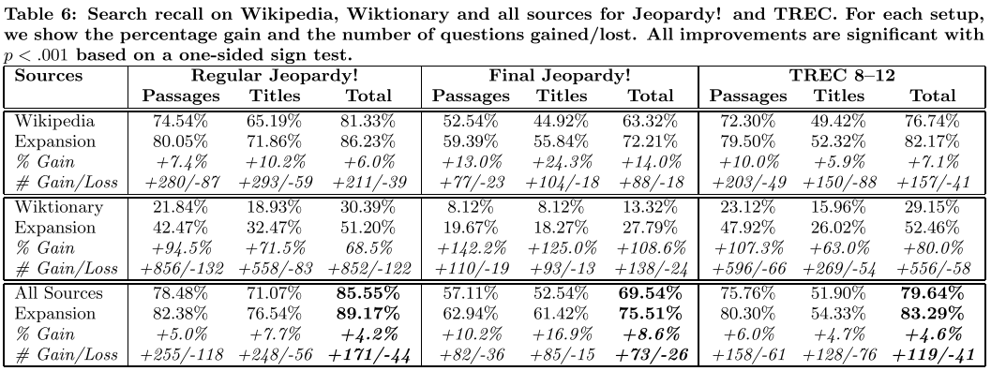
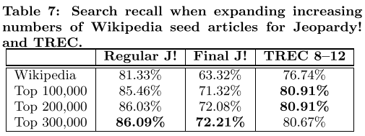
Application to QA
QA search Experiments
Recall
Answered question / all question

Slide 30
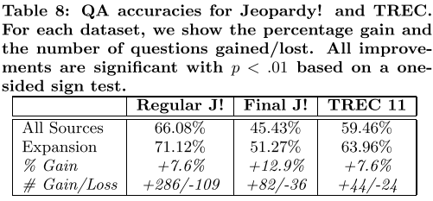
Application to QA
accuracy

Slide 31
Conclusion
We proposed a statistical approach for source expansion
The proposed method yields significant gains in search performance on all datasets, improving search recall by 4.2–8.6%.
SE also improves the accuracy by 7.6–12.9% on Jeopardy! and TREC datasets.

